Slide 1
Session 10 Generics (http://docs.oracle.com/javase/tutorial/java/generics/ index.html)
Generic: same type
Notes:
Based on the OOP polymorphism and Object is the ultimate Java classes. We can create a list of arbitrary objects. However, the cost for accessing an element in an arbitrary list is the type-casting must be used. In addition to support utilities if the list contains elements which are generic ( they belong to the same type), this technique supports a ways to prescribe limitations of types of elements.

Slide 2
What is Generics?
A technique allows programmers creating general processes on data whose data types are not determined (generic is not used) or they can be determined (generic is used) when they are used.
A way allows programmer implementing general algorithms which can be used to process multi-type input → Polymorphism.

Slide 3
Objectives
How we can create a list of arbitrary elements?
Generics in Java API (java.util pakage)
Advantages of Generics
How to create a generic class/ method/ interface
How is a generic class treated by compiler?
How to give bounded type parameters?
Restrictions on Generics

Slide 4
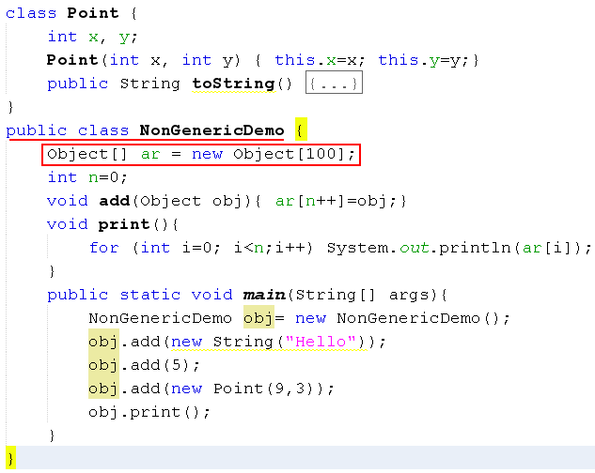

A list of arbitrary elements
Reference type conformity: fatherRef=sonRef
The Object class is the ultimate class of all Java class
We can create a list of elements which can belong to different classes
A demonstration:

Slide 5
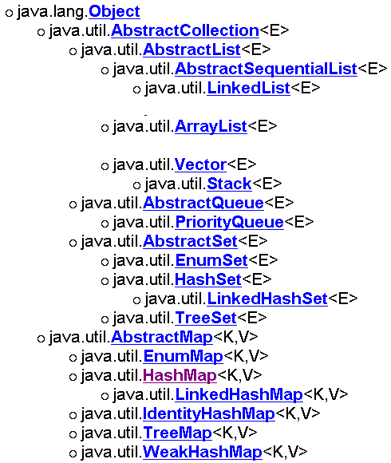
Generic Classes in java.util
Almost of interfaces and classes related to lists in the Java API declared as generic.
Type Parameter Naming Conventions
By convention, type parameter names are single, uppercase letters.
The most commonly used type parameter names are:
E : Element/ K: Key
N – Number/ T - Type
V - Value
S,U,V etc. - 2nd, 3rd, 4th types

Slide 6
Generics on a List
Sometimes, we want to create a list with restrictions as elements must belong to some types → Generic
Generic is a technique which allows a list of arbitrary objects and supports advantages if elements of a list belong to the same data type.

Slide 7
Advantages of Generics
Generics add stability to your code by making more of your bugs detectable at compile time.
Generics enable types (classes and interfaces) to be parameters when defining classes, interfaces and methods and limits on parametric types may be declared.
Code that uses generics has many benefits over non-generic code.
Stronger type checks at compile time
Elimination of casts.
Enabling programmers to implement generic algorithms.

Slide 8
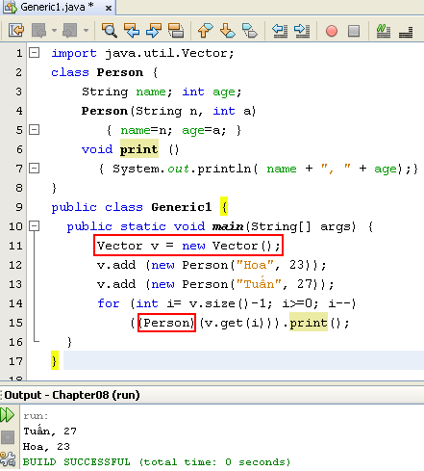
Generics are not used
The package java.util supports general-purpose implementations which allows lists containing arbitrary elements
The cost of this flexibility is we may have to use a casting operator when accessing an element.
The class Object does not have the print() method

Slide 9
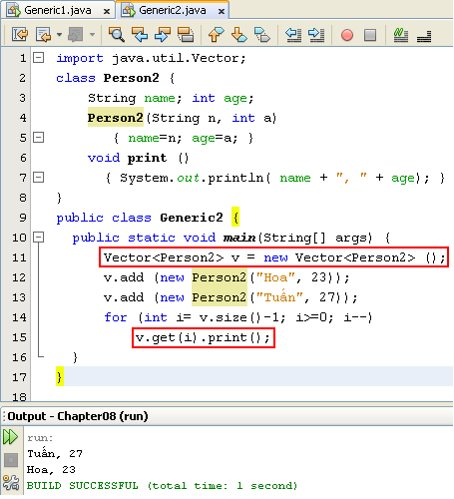
Generics are used
If all elements of the collection are homogeneous(identical), the generic technique should be used.
Generics add stability to your code by making more of your bugs detectable at compile time. Casting can not be used.
The casting operators are missed.

Slide 10
Using Generics- Syntax
Invoking and Instantiating a Generic Type
Box<Integer> integerBox = new Box<Integer>();
The Diamond
Box<Integer> integerBox = new Box<>();
Multiple Type Parameters
Pair<String, Integer> p1 = new OrderedPair<String, Integer>("Even", 8);
Parameterized Types
OrderedPair<String, Box<Integer>> p = new OrderedPair<>("primes", new Box<Integer>(...));

Slide 11
Implementing a Generic class
Syntax:
class name<T1, T2, ..., Tn> {
code
}
public class Box<T> {
// T stands for "Type"
private T t;
public void set(T t) { this.t = t; }
public T get() { return t; }
}

Slide 12
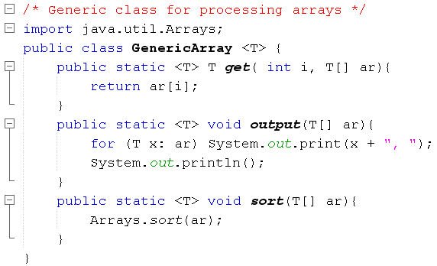
Implementing Generic Methods

Slide 13
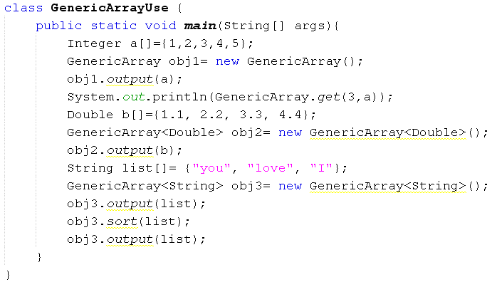

Implementing Generic Methods…
Generic is not used
Generic is used

Slide 14
How generic class is treated?
Compiler will save generic information in this class to class files (file.class)
When this class is used ( an object of this class is created)
If an argument types are declared: Compiler updates type information.
If no argument type is declared, type information in parameters are erased or changed to Object

Slide 15
Implementing a Generic Methods
Generic methods are methods that introduce their own type parameters.
The type parameter's scope is limited to the method where it is declared.
The syntax for a generic method includes a type parameter, inside angle brackets, and appears before the method's return type.
public static <K, V> boolean equals(Pair<K, V> p1, Pair<K, V> p2) {
return p1.getKey().equals(p2.getKey()) &&
p1.getValue().equals(p2.getValue());
}

Slide 16
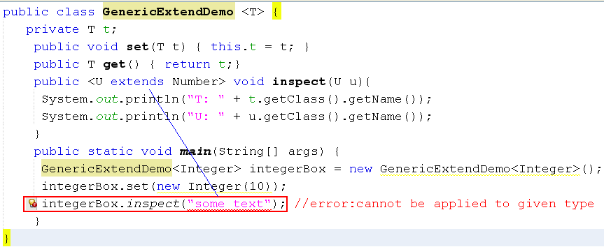
Bounded Type Parameters
Restriction on types of arguments when a method is called.

Slide 17
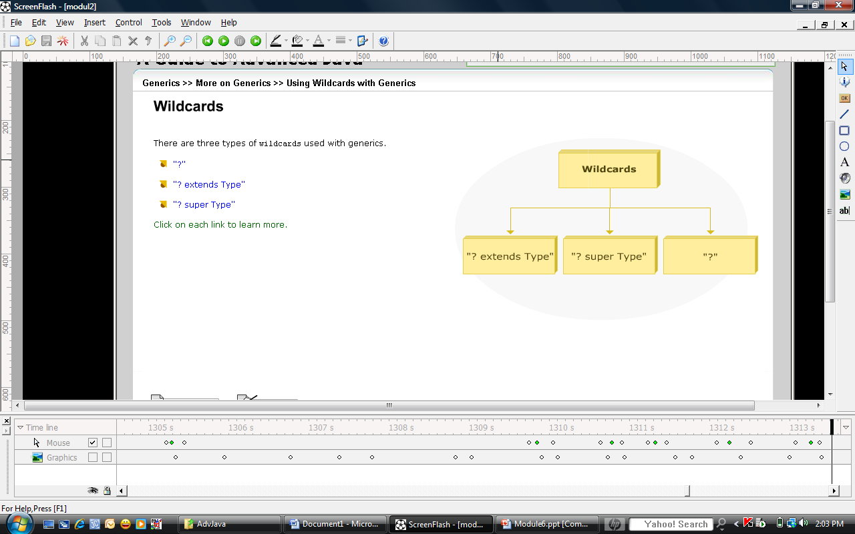
Bounded Type Parameters: Using wildcarts
Object
A
B
C
D
E
The ? stands for an unknown type
? extends Type : a bounded wildcard. Type is upper bound
? super Type : a bounded wildcard. Type is lower bound
Notes:
? : bất cứ cái gì
ViDu: ? extends C meanings Bất cứ cái gì kế thừa từ C (D và E)
? super C meanings Bất cứ cái gì C được kế thừa (A và B)

Slide 18
Wildcards
The question mark (?), called the wildcard, represents an unknown type.
The wildcard can be used in a variety of situations: as the type of a parameter, field, or local variable.
The wildcard is never used as a type argument for a generic method invocation, a generic class instance creation, or a super type.

Slide 19
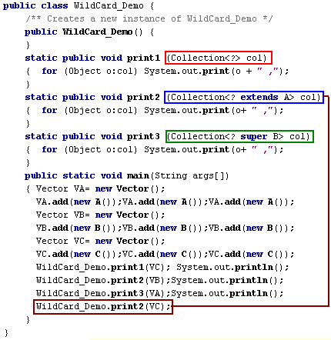
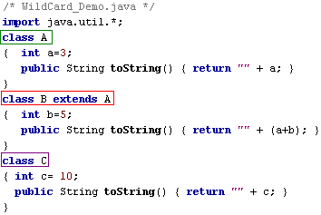
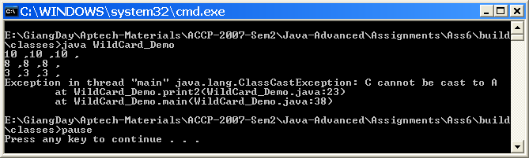
Wildcards Demo.

Slide 20
Raw Types
When a generic type like collection is used without a type parameter, it is called a raw type. Compiler will execute erasure process to remove all generic type information. All the type information between angle brackets are thrown out.
public class Box<T> {
public void set(T t) { /* ... */ }
// ...
}
//…
Box<String> stringBox = new Box<>();
Box rawBox = stringBox;
Box rawBox = new Box(); // rawBox is a raw type of Box<T>
Box<Integer> intBox = rawBox; // warning: unchecked conversion

Slide 21
Type Erasure
Type erasure will
Replace all bounded type parameters in generic types with their bounds
public <U extends A> void inspect (U obj)
→ public void inspect (A obj)
Change unbounded type parameter to Object
public void f (T obj)
→ public void f (Object obj)
Insert type casts if necessary to preserve type safety.
Generate bridge methods to preserve polymorphism in extended generic types.
➔ The produced bytecode, therefore, contains only ordinary classes, interfaces, and methods.

Slide 22
Type Erasure – Demo.
Erasure of Generic Method
Type information is erased.
public static <T> int count(T[] anArray, T elem) {
int cnt = 0;
for (T e : anArray)
if (e.equals(elem))
++cnt;
return cnt;
}
//T is unbounded, the Java compiler replaces it with Object
public static int count(Object[] anArray, Object elem) {
int cnt = 0;
for (Object e : anArray)
if (e.equals(elem))
++cnt;
return cnt;
}

Slide 23
Restrictions on Generics
Cannot Instantiate Generic Types with Primitive Types.
Cannot Create Instances of Type Parameters.
Cannot Declare Static Fields Whose Types are Type Parameters.
Cannot Use Casts or instanceof With Parameterized Types.
Cannot Create Arrays of Parameterized Types.
Cannot Create, Catch, or Throw Objects of Parameterized Types.
Cannot Overload a Method Where the Formal Parameter Types of Each Overload Erase to the Same Raw Type.

Slide 24
Summary
Generics on methods, classes and collections
Bounded Type Parameters
Working with Wildcards
Working with type erasure
Generic restrictions

